Slide 1

Simulating the clonal growth with the presence of quiescent stem cells
Aaron

Slide 2
Cancer stem cell
Self – renewal
Proliferative
Able to differentiate into other types of cells

Slide 3
Quiescent stem cell
Notes:
Lazy
sleeping

Slide 4
Cancer stem cell → tumour development

Slide 5
Cancer stem cell → tumour development
+
CSC
CSC
CSC
CSC
+
PC
CSC
PC
PC
+
PC
PC
DC

Slide 6
Stochastic simulation
8
7
6
5
4
3
2
1
0
+
CSC
CSC
CSC
The number of PC
+
PC
CSC
0 1 2 3 4 5 6 7 8
The number of CSC

Slide 7
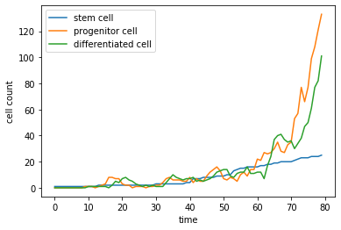
Simulation result
Clonal growth
Distribution of clone size

Slide 8
Simulation for a new model
+
CSC
CSC
CSC
PC
QSC
CSC
+
PC
CSC
QSC
CSC
PC
PC
+
PC
PC
DC

Slide 9
Implication
PC
CSC
QSC

Slide 10
Thank you!

